Slide 1
Programming Fundamentals
Course Code: CS-111
Course Instructor: Isra Naz

Slide 2
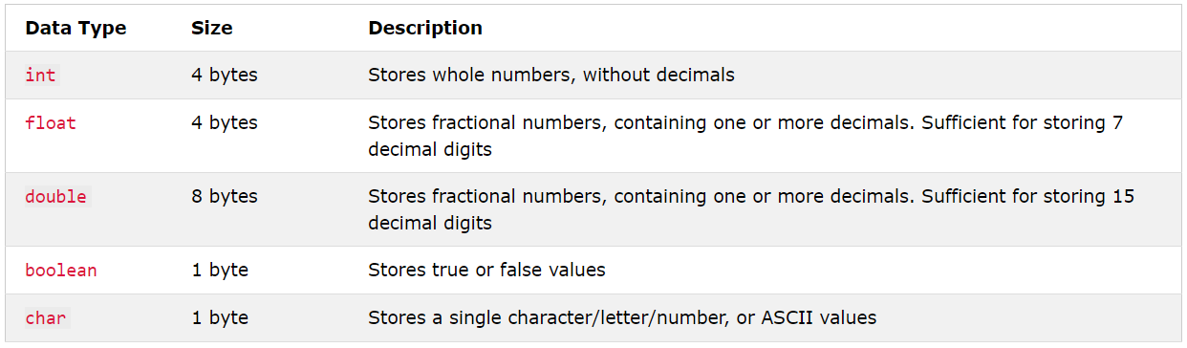
Data Types
C++ has five basic data types

Slide 3
Data Types Example
int myNum = 5; // Integer (whole number) float myFloatNum = 5.99; // Floating point number double myDoubleNum = 9.98; // Floating point number char myLetter = 'D'; // Character bool myBoolean = true; // Boolean string myText = "Hello"; // String

Slide 4
Token
A token is the smallest element of a program that is meaningful to the compiler. Tokens can be classified as follows:
Keywords
Identifiers
Constants
Strings
Special Symbols
Operators

Slide 5
Keywords
Keywords are pre-defined or reserved words in a programming language.
Each keyword is meant to perform a specific function in a program.
Since keywords are referred names for a compiler, they can’t be used as variable names

Slide 6
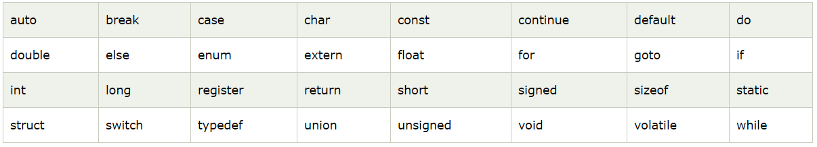
Common Keywords
A list of 32 Keywords in C++ Language which are also available in C language are given below.

Slide 7
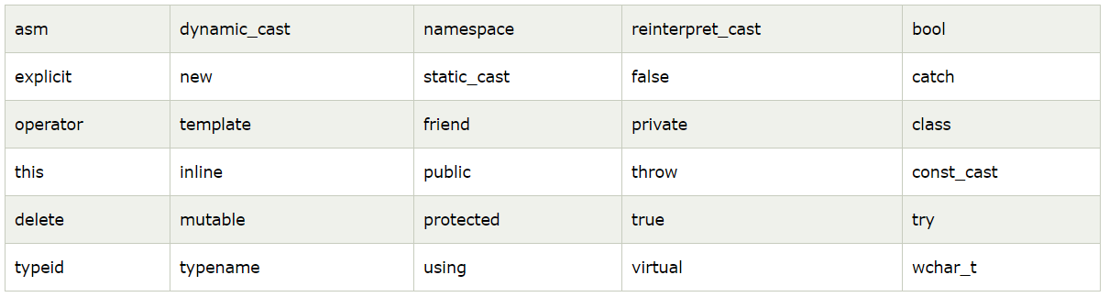
Common Keywords
A list of 30 Keywords in C++ Language which are not available in C language are given below.

Slide 8
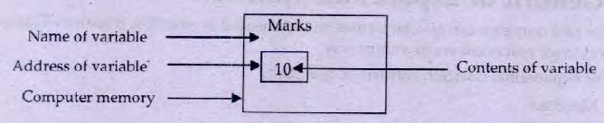
Variables
Quantity whose value changes during the execution of program
Variable name represents memory location in computer.
Data is stored in the memory location
Consist of alphabets and digits

Slide 9
Declaration of variables
Assigning name and data type that variable can hold is called variable declaration.
Syntax:
DataType list-of-variables;
Examples:
int x;
int a, xyz, k;
float b, ab;
char n;

Slide 10
Declaration of variables
Variables Naming rules
Only Alphabets, Digits and Underscores are permitted.
Identifier/ variable name cannot start with a digit.
Key words cannot be used as identifier name.
Upper case and lower case letters are distinct.
Special Characters are not allowed
A variable can be declared for only one data type.

Slide 11
Identify valid and invalid variables
Name
name
int
$SUM
name_1
Int
INT
Num^2
_SUM
Sum_of_Numbers
Num 1
FirstName
2Num

Slide 12
Declaration of a variable
Valid Variables Names
Identifier | Note
Name | Capital Letter and Small Letters are Allowed
name | Small Letters are allowed
name_1 | Digits and Underscore is allowed along with alphabets
Int | Keywords are allowed but we have to change case of any letter or complete word
INT | Keywords are allowed but we have to change case of any letter or complete word
_SUM | Underscore at the first position is allowed in C++ language
sum_of_numbers | We can concatenate multiple words with underscore
firstName | Best Style to concatenate multiple words (Changing case of First Letter of Successive Word)

Slide 13
Declaration of a variable
Invalid Variables Names
Identifier | Explanation
int | Keyword name cannot be given to Variable/Identifier
$sum | $ sign can be used in other programming language for creating identifier, however C/C++ do not support ‘$’ sign.
num^2 | special characters are not allowed.
num 1 | Spaces are not allowed in C++ programming language for declaring identifier.
2num | Digits are allowed but not as first Character

Slide 14
Initialization of a variable
Assigning value to a variable at the time of declaration is called initialization of the variable.
Syntax
Datatype identifier = initial_value ;
Example
int n = 50;
int a=2 , b= 6 , c=10 ;
char grade= ‘A’;
string name = “Ali”;
float avg = 85.5;

Slide 15
Example
#include<iostream>
using namespace std;
int main()
{
int a=2,b=3;
float x= 3.2;
cout<<“Integer number”<<a<<endl;
cout<<“Integer number”<< b<<endl;
cout<<“Decimal number”<<x<<endl;
}
Variable initialization
Print values on output

Slide 16
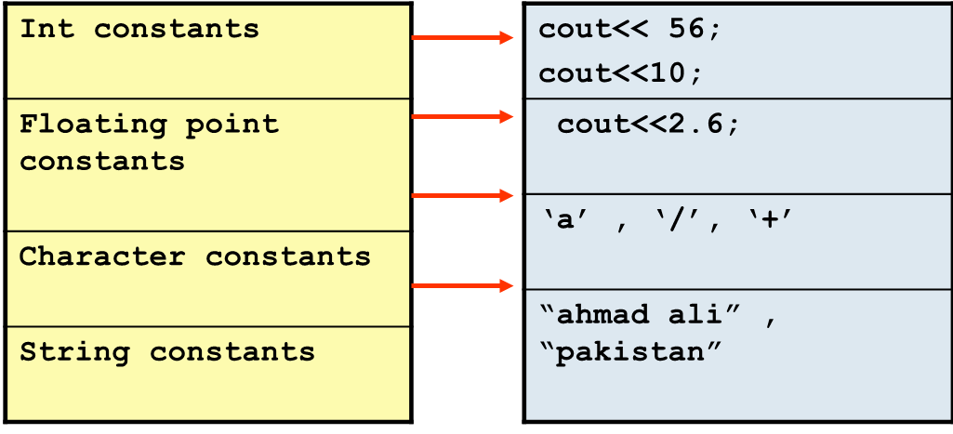
Constants
A quantity that can not change its value during program execution is called constants
There four type of constants in C++

Slide 17
Constants Cont…
Constant qualifier:
To avoid override existing variable values, use the const keyword (this will declare the variable as "constant", which means unchangeable and read-only
E.g
const float pi = 3.14;
Define directive:
Preprocessor directive, used to define constant quantity is
#define p 3.14

Slide 18
Example
# include <iostream>
using namespace std;
#define Pi 3.141
int main()
{
float r, area;
Cout<<“Enter radius:\n”;
Cin>>r;
Area=2.0 *Pi*r;
Cout<<“circumference of circle:”<<area;
}

Slide 19
Operators
Operators are the symbol that are used to perform certain operation on data.
C++ provides variety of operators such as
Arithmetic Operators
Assignment operators
Relational operators
Logical operators

Slide 20
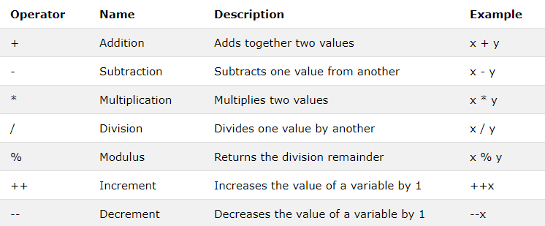
Arithmetic operators
Arithmetic operators are used to perform common mathematical operations.
Some arithmetic operators are

Slide 21

All the operators on previous slide are binary operators as they require two operands.
C++ applies the operators in arithmetic expressions in a precise sequence determined by the following rules of operator precedence, which are generally the same as those followed in algebra

Slide 22

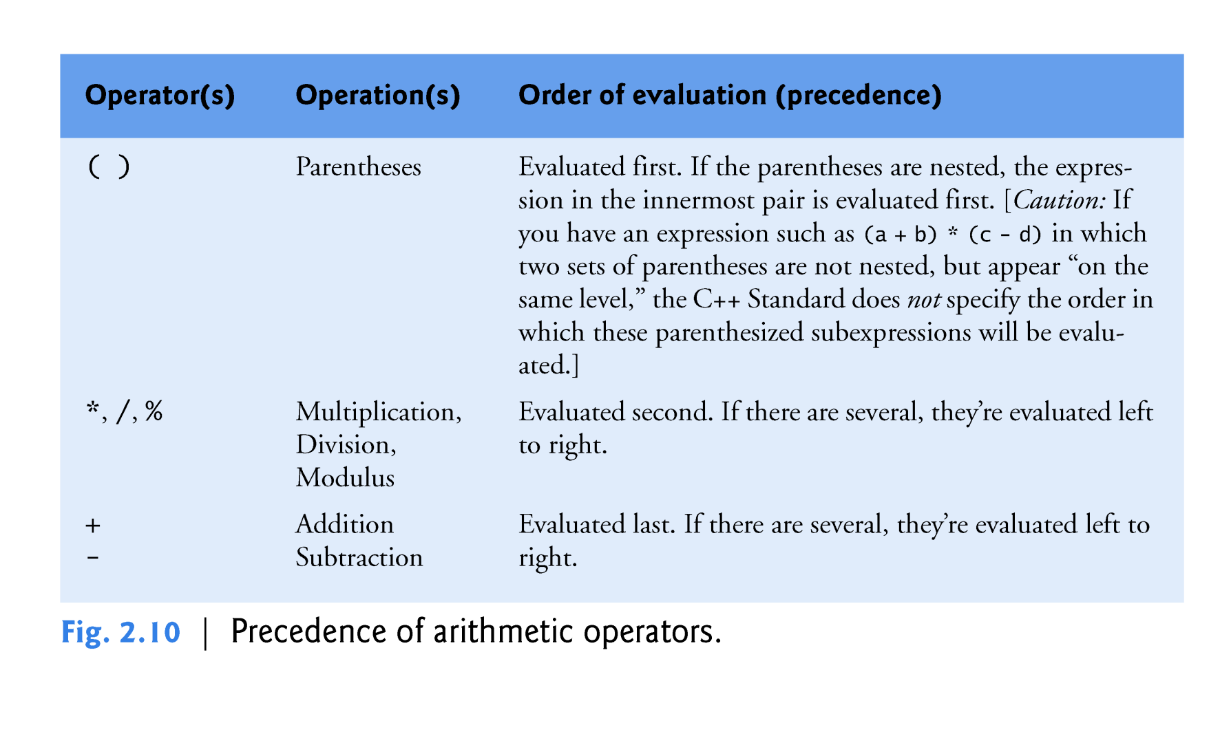

Slide 23
Example
Output:
46
1
int i=5,j=6,k=7,n=3;
cout<<i+j*k-k%n<<endl;
cout<<i/n<<endl;

Slide 24
Assignment Operators
Assignment operators are used to assign values to variables.
The assignment operator = is used in assignment statement to assign a value or computational result to a variable.
Syntax
VariableName = expression;
Example
A=100;
C=A+B;
X=C-D+10;

Slide 25
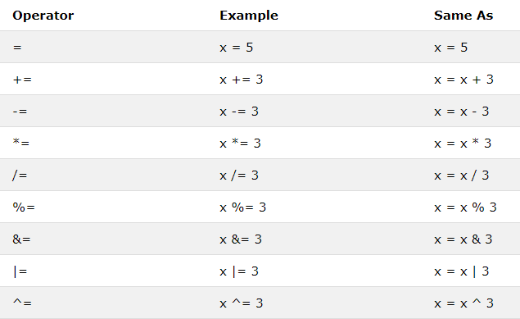
Compound Assignment Operators
C++ language provides compound operators that combine assignment operator with arithmetic operators.
Syntax
Variable op=expression

Slide 26
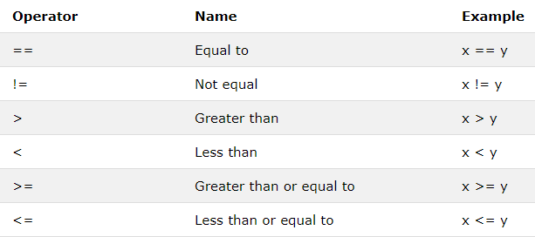
Comparison Operators
Comparison operators are used to compare two values.
The return value of a comparison is either true (1) or false (0).
List of comparison operators are:

Slide 27
Example
int x = 5; int y = 3; cout << (x > y); // returns 1 (true) because 5 is greater than 3

Slide 28
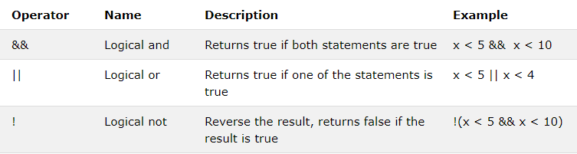
Logical Operators
Logical operators are used to determine the logic between variables or values:
Logical operators are:
AND &&
OR ||
NOT !

Slide 29
 C++ also provides two unary operators for
adding 1 to value of a variable or
subtracting 1 from the value of a numeric variable.
These are the
unary increment operator ++
unary decrement operator --

Slide 30
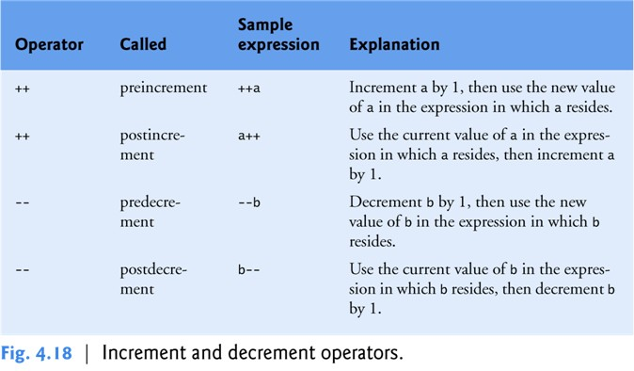

Slide 31
Example
Output:
value of c = 10
value of c = 11
value of c = 11
value of c = 11
value of c = 12
void main()
{
int c = 10;
cout<< “value of c = “<< c <<endl;
cout<< “value of c = “<< ++c <<endl;
cout<< “value of c = “<< c <<endl;
cout<< “value of c = “<< c++<<endl;
cout<< “value of c = “<< c <<endl;
}

Slide 32
Example
Output:
10 , 16
int x=10, y=15;
x = x++;
y = ++y;
cout<<x<< “, “ <<y;

Slide 33
Example
Output:
10
int n = 10;
int x = 0;
x = n--;
cout<<x<<endl;

Slide 34
Example
Write a program that inputs dividend and divisor. It then calculates and displays the quotient and remainder.
int main()
{
int div, dis, q, r;
cout<<“Enter dividend & divisor:”;
cin>>div>>dis;
q=div/dis;
r=div%dis;
cout<<“Quotient=“<<q<<endl;
cout<<“Remainder=“<<r<<endl;
}

Slide 35


